Slide 1
15 - Monte Carlo Sampling
Dr. Hamish Carr & Dr. Rafael Kuffner dos Anjos

Slide 2
Agenda
Random generators
Monte Carlo method

Slide 3

Random Generators
Random numbers are fair and unpredictable
Computer provides pseudo-random number
Functions in <stdlib.h>
random() returns 0 .. RAND_MAX
divide by RAND_MAX to get [0,1]
then scale & translate

Slide 4
Example
// generates a random value
GLfloat RandomRange(GLfloat min, GLfloat max)
{ // RandomRange()
// compute range for scaling
GLfloat range = max - min;
// generate pseudorandom number in [0,RAND_MAX]
GLfloat randomNumber = (GLfloat) random();
// convert to [0,1]
randomNumber /= (GLfloat) RAND_MAX;
// scale
randomNumber *= range;
// translate
randomNumber + min;
// return result
return randomNumber;
} // RandomRange()

Slide 5
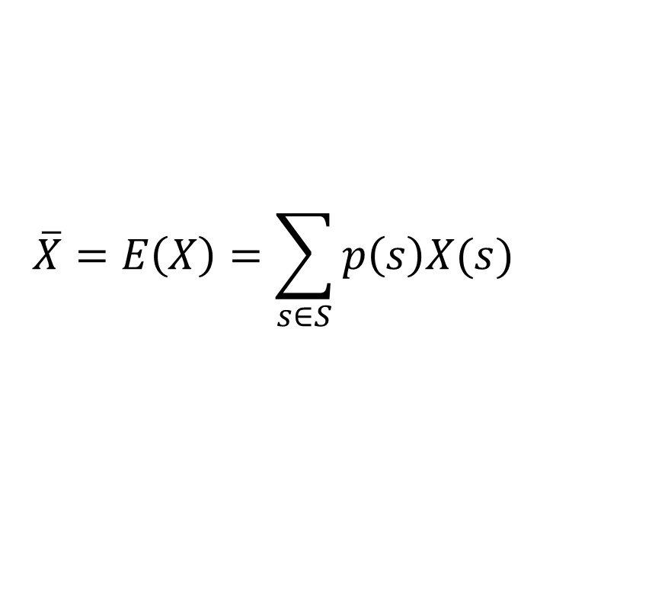
Expected Value
Given a “random variable” X
What value do we expect?
Multiply probability of value by value
Then sum over all values
Also known as the mean or the average
$$\overline{X}=E\left(X\right)=\sum_{s∈S}{p\left(s\right)X(s)}$$

Slide 6

Variance
How tightly the value clusters
Take the difference from the mean
Square it & add them together
It’s square root is the standard deviation
$$Var\left[X\right]=E[{\left(X−\overline{X}\right)}^{2}]$$

Slide 7
Sampled Integration
Instead of regular intervals for integration
Use random samples
The variance of the estimate is better
I.e. it converges faster
Regular Intervals
Uniform Sampling

Slide 8
Importance Sampling
Large values dominate the variance
i.e. they are more important
So choose them more frequently
And weight samples for right result
Uniform Sampling
Importance Sampling

Slide 9


Moving to 3D
This is easy for functions $f:ℝ→ℝ$
But gets harder for higher dimensions
So let’s look at another aspect of this:
Monte Carlo Sampling

Slide 10
Random (x,y) points
Directional Bias
Generate random x, random y
Directions not equally likely
Diagonals more likely

Slide 11
Circular Distribution
All directions equally probable
Could use random angle theta
Breaks down in 3D (texture distortion)

Slide 12
Monte Carlo Method
Generate points in a square
Discard points outside the circle

Slide 13
Monte Carlo Code
Vector2D 2DMonteCarloVector()
{ // 2DMonteCarloVector()
// loop until we get a valid one
while (true)
{ // while loop
// randomise x and y
Vector2D aVector;
aVector.x = RandomRange(-1.0, 1.0);
aVector.y = RandomRange(-1.0, 1.0);
// compute length & compare
float length = aVector.Length();
// return if it’s good
if (length <= 1.0)
return aPoint;
} // while loop
// this should never be called - but it makes the compiler happy
return Vector2D(0.0, 0.0);
} // 2DMonteCarloVector()

Slide 14
Refinements
Avoid taking the square root
1
Discard points inside as well
2
avoids degenerate cases
Normalize vectors to unit
3
Perfect for raytracing
Unless you want a vector not a direction

Slide 15
3D Monte Carlo Code
Vector3D 3DMonteCarloDirection()
{ // 3DMonteCarloDirection()
// loop until we get a valid one
while (true)
{ // while loop
// randomise x, y, z
Vector3D aVector;
aVector.x = RandomRange(-1.0, 1.0);
aVector.y = RandomRange(-1.0, 1.0);
aVector.z = RandomRange(-1.0, 1.0);
// compute length & compare
float length = aVector.Length();
// if the length is bad, do another loop
if ((length > 1.0) || (length < 0.1))
// otherwise, return the normalised version
return aVector.UnitNormal();
} // while loop
// this should never be called - but it makes the compiler happy
return Vector3D(0.0, 0.0, 0.0);
} // 3DMonteCarloDirection()

Slide 16

Downsides
We’re wasting samples
On the region outside the circle
We want an efficient solution
That doesn’t waste random numbers
We re-parameterise the computation

Slide 17
Weighting Factor
This turns out to be equal-area mapping
An idea long understood in cartography
Weight the sample by it’s local distortion
Known as the Jacobian
Related to the slope

Slide 18

Random Hemisphere
We weight the probability by this area
It turns out to be a sine function
And there's a short cut
$$f:\left[0,1\right]×\left[0,1\right]→H:\left(u,v\right)→(\cos\left(2πu\right),v,\sin\left(2πu\right))$$

Slide 19
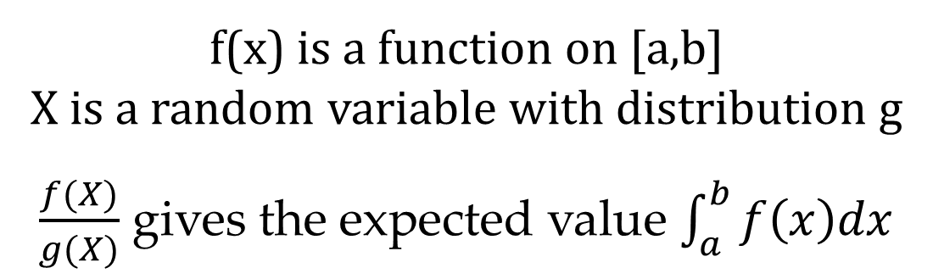
Importance Sampling
Large values have more influence on variance
So we sample them more frequently
Increases contribution to the integral
So we counterweight their contribution
Net result: same mean, smaller variance
f(x) is a function on [a,b]
X is a random variable with distribution g
$\frac{f(X)}{g(X)}$ gives the expected value $\int_{a}^{b}{f\left(x\right)dx}$

Slide 20
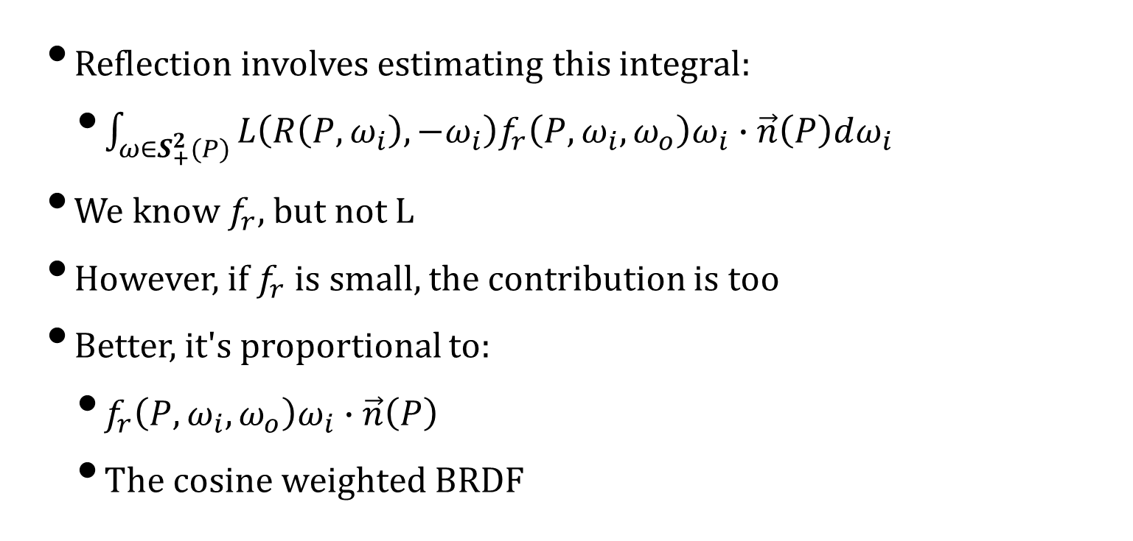
In practice
Reflection involves estimating this integral:
$\int_{ω∈S_{+}^{2}(P)}^{ }{L\left(R\left(P,ω_{i}\right),−ω_{i}\right)f_{r}\left(P,ω_{i},ω_{o}\right)ω_{i}∙\vec{n}\left(P\right)dω_{i}}$
We know $f_{r}$, but not L
However, if $f_{r}$ is small, the contribution is too
Better, it's proportional to:
$f_{r}\left(P,ω_{i},ω_{o}\right)ω_{i}∙\vec{n}\left(P\right)$
The cosine weighted BRDF

Slide 21
Images by
S9: Fakurian Design
S16: Kaleb Tapp

